Slide 1


User Journey for
Quest LXH Application
July 31st, 2025

Slide 2
User Journey
If user cancels, “not verified” messaging appears
1
Accessing application via the patient dashboard
User views the patient profile
User selects “Apps” – “Quest Diagnostics”
User must click “I agree”
2
User accesses multiple views of patient record
User can view list of results by different timeframes
User can select tests groups drop down
Test Groups drop down Example (cardiology)
3
User views details of test and can choose to print results
User can search by specific test such as Triglycerides (example)
User can select all Out-of-Range test results via toggle view
User can view test results in chart view

Slide 3
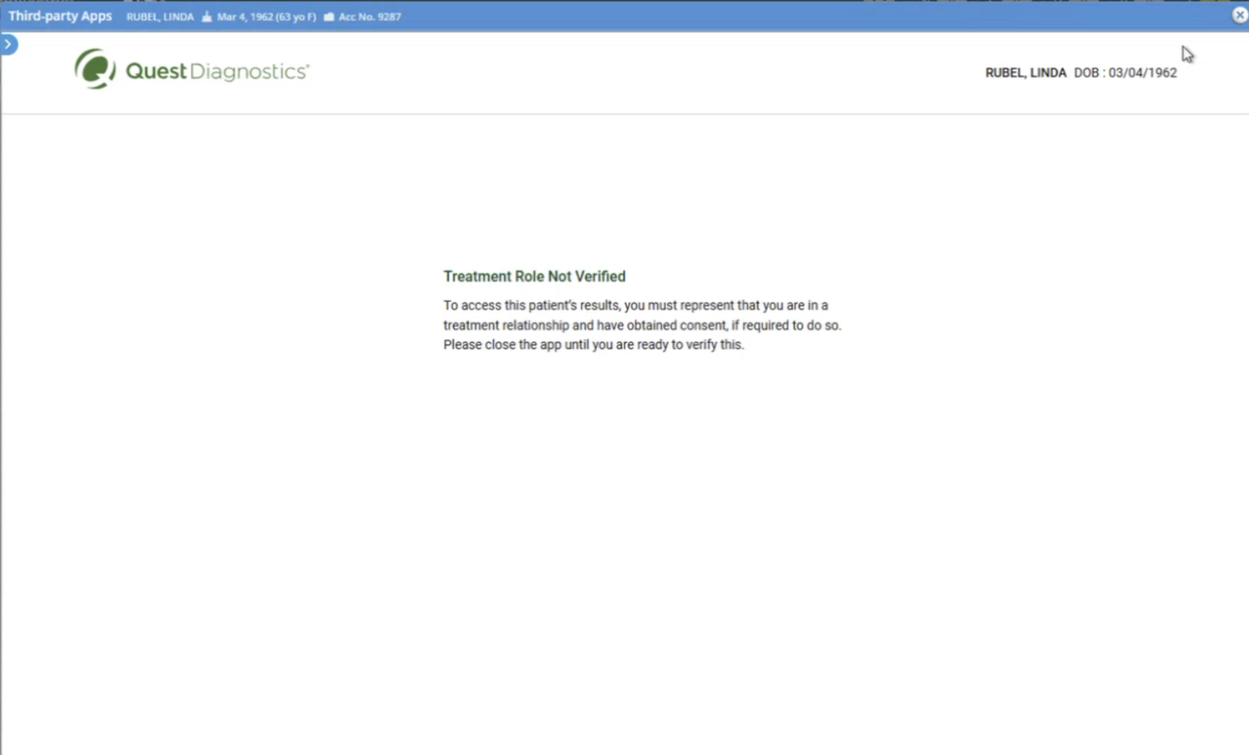
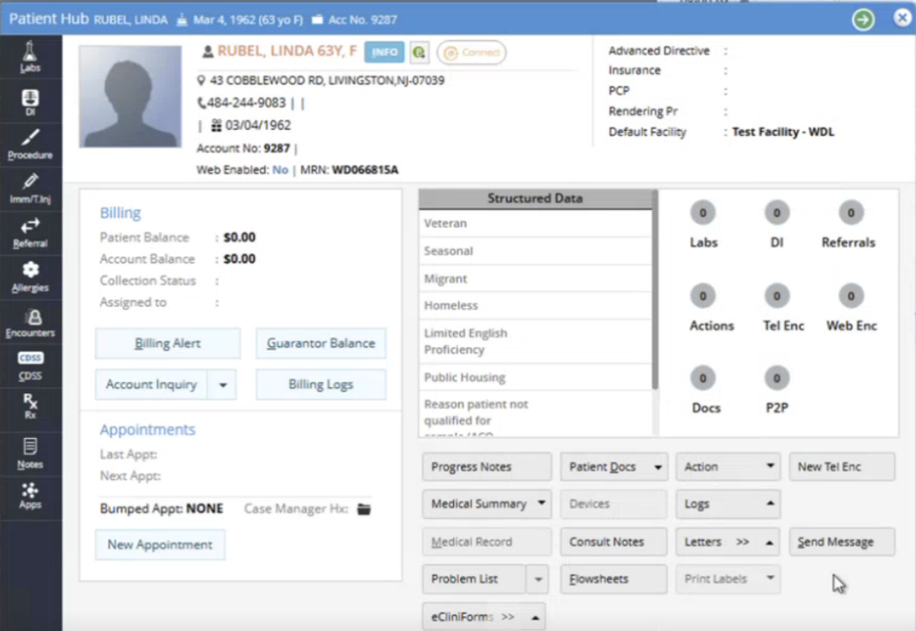
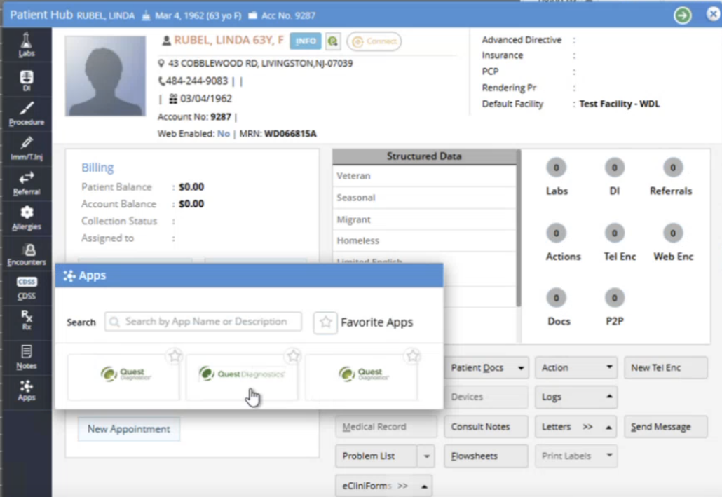
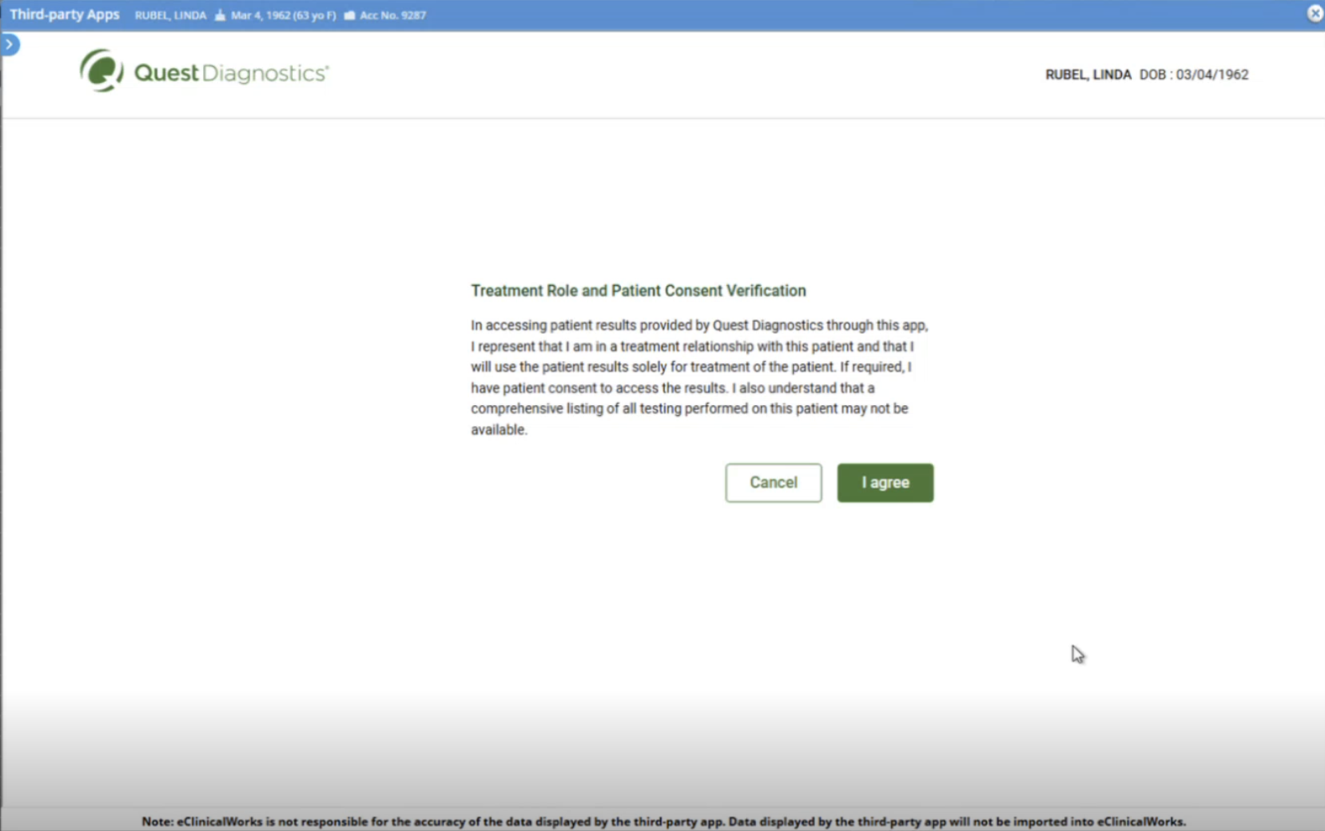
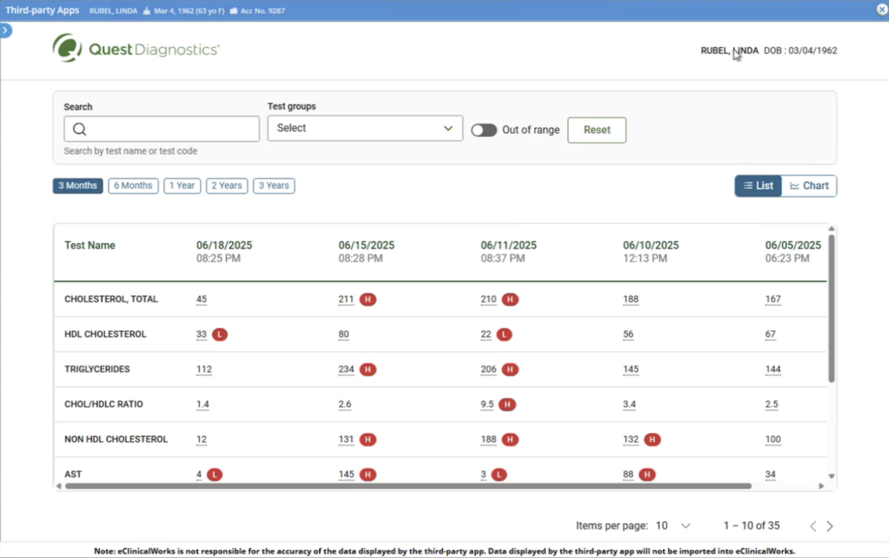
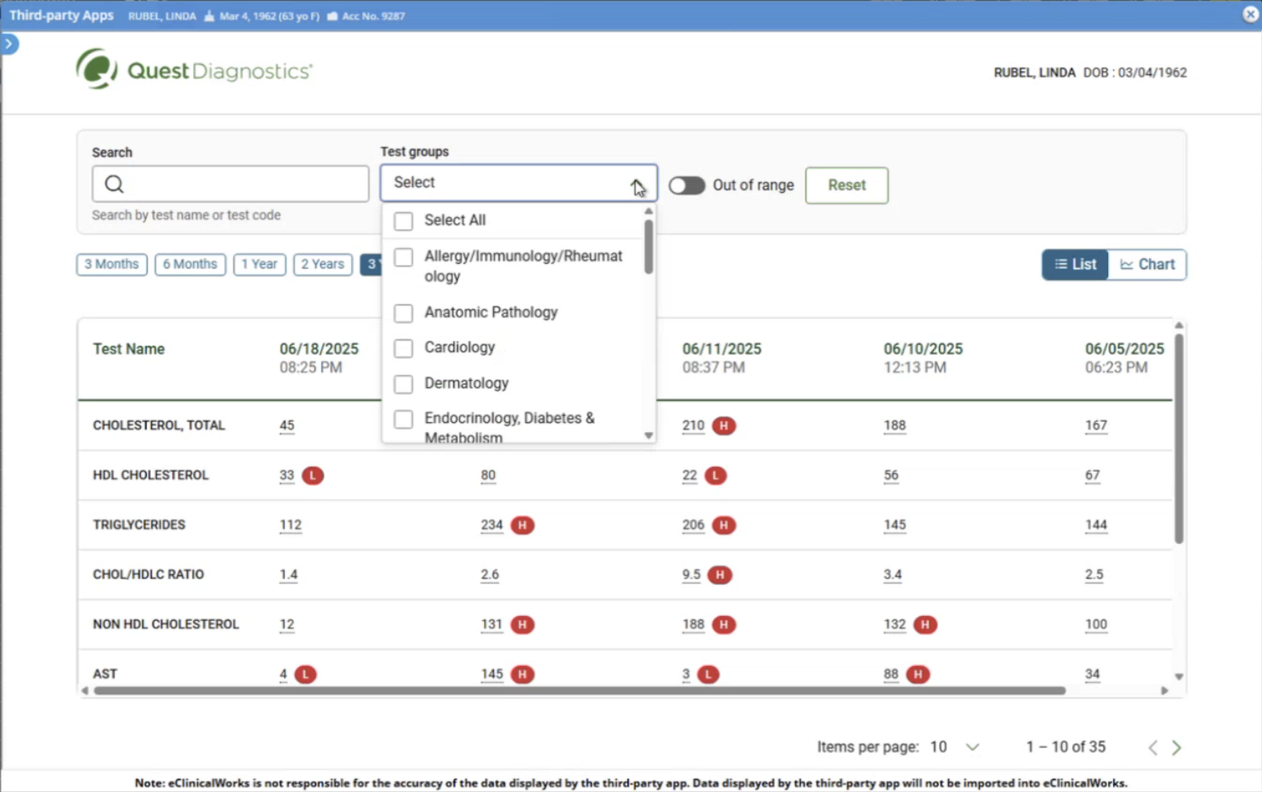
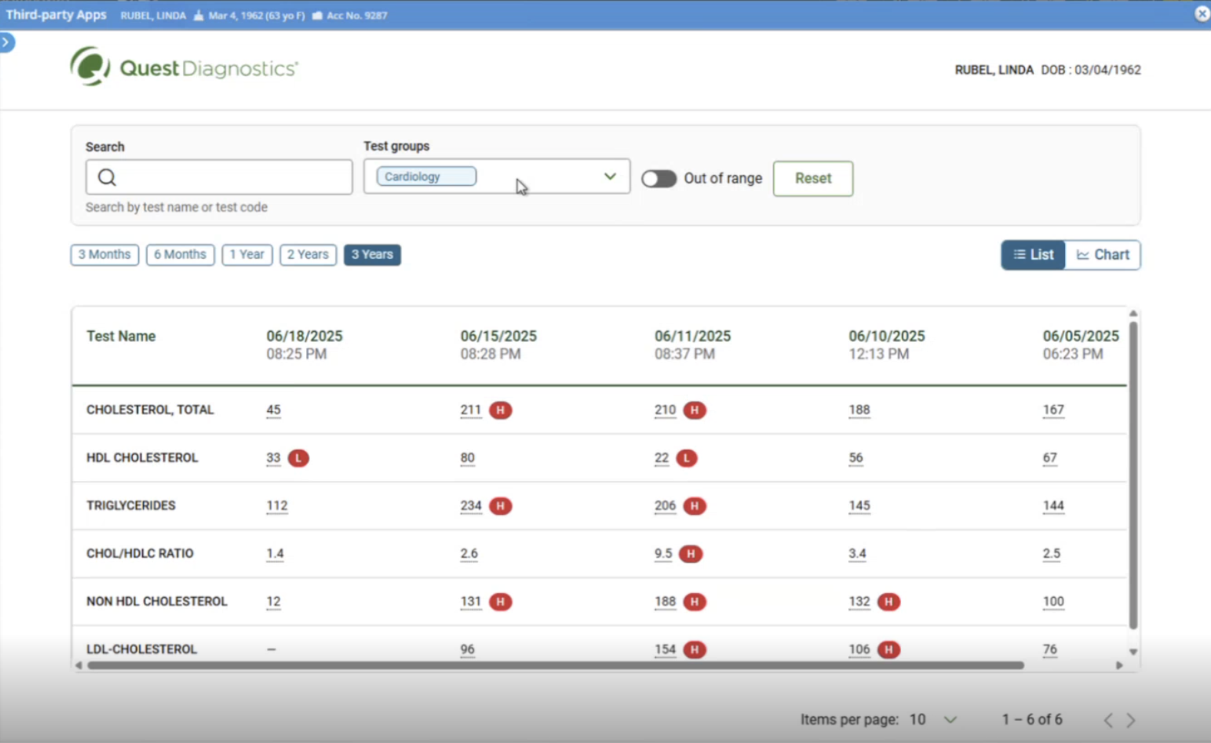
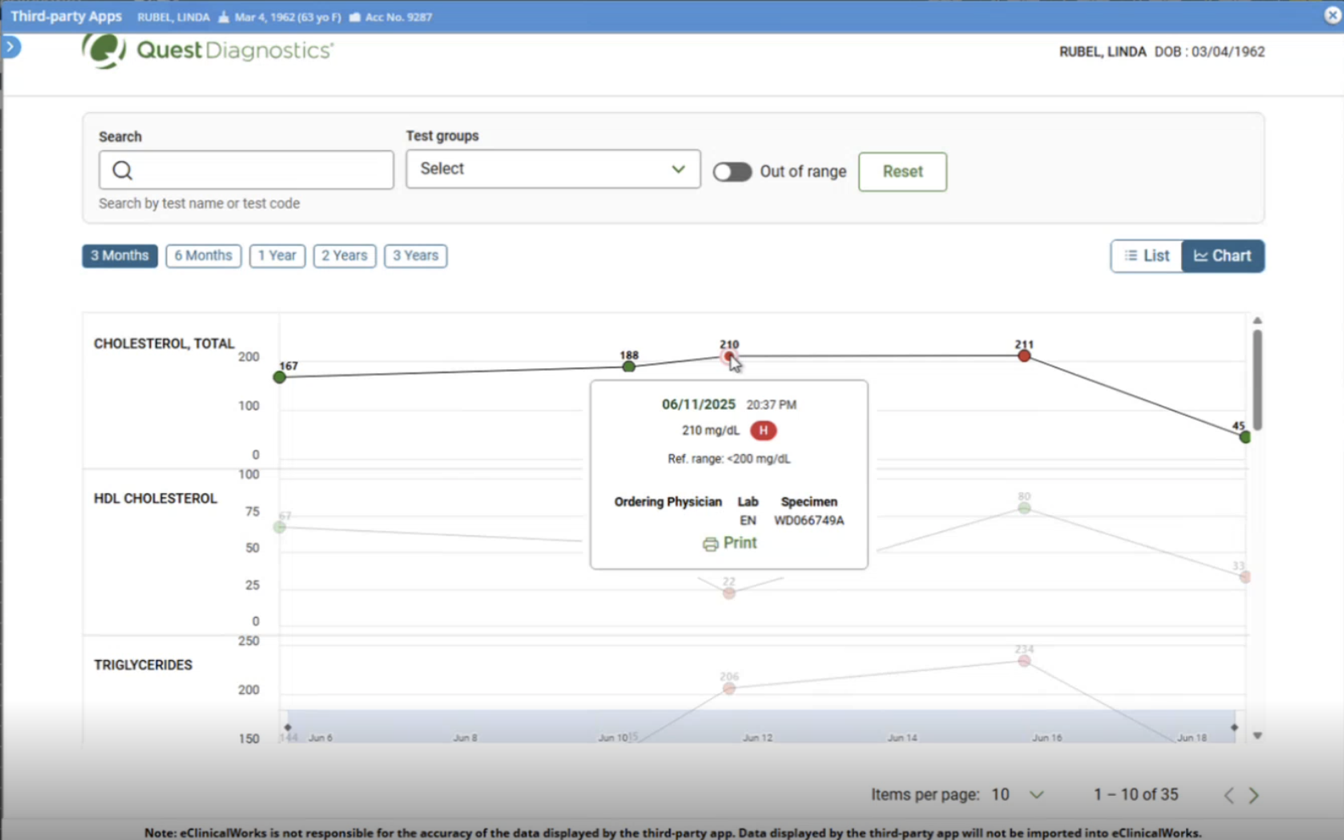
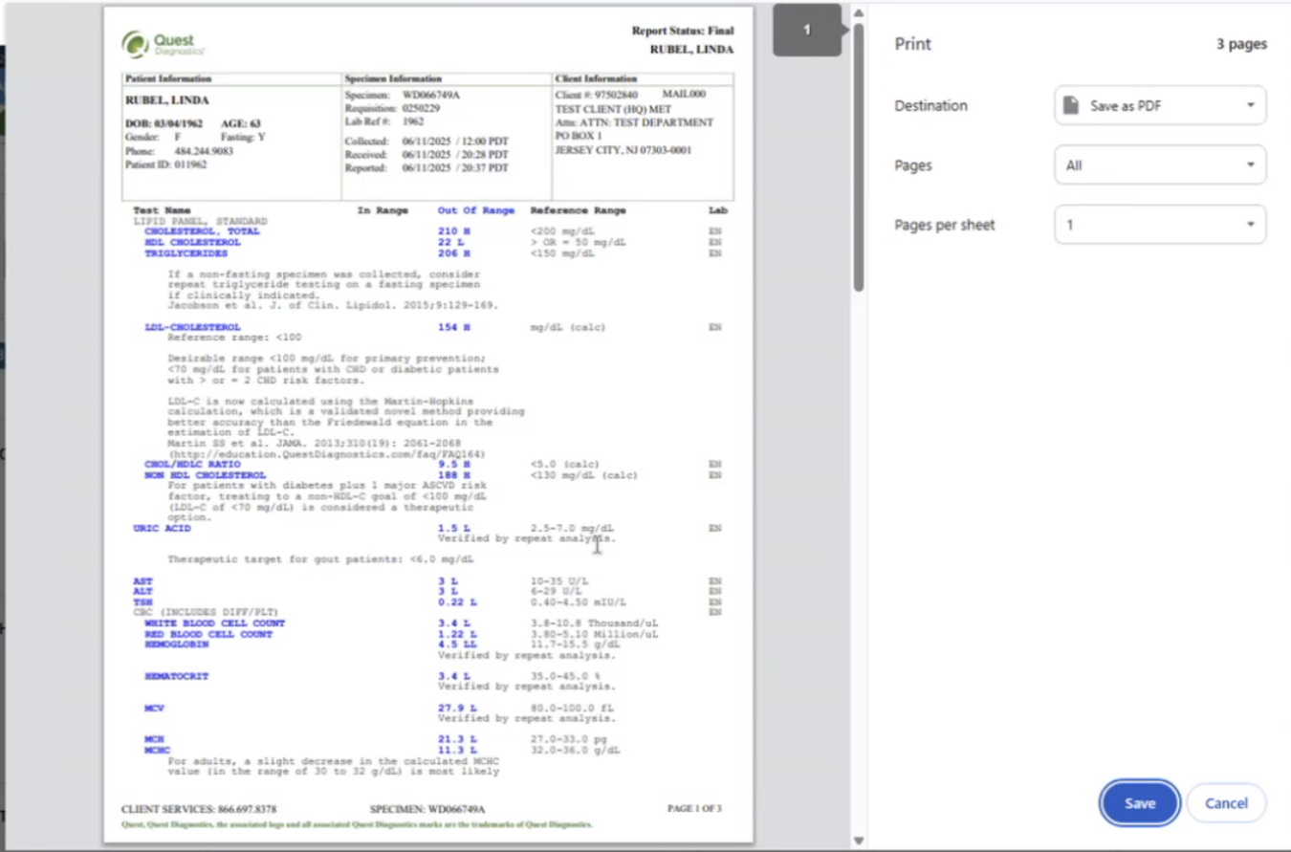
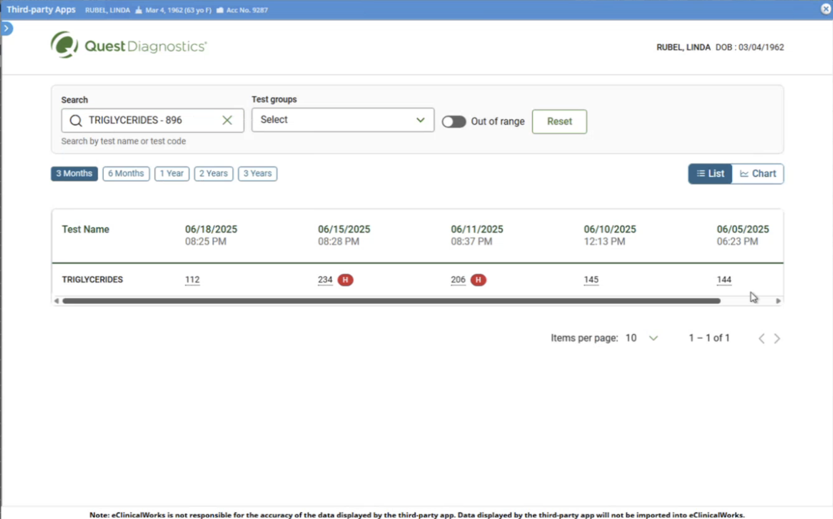
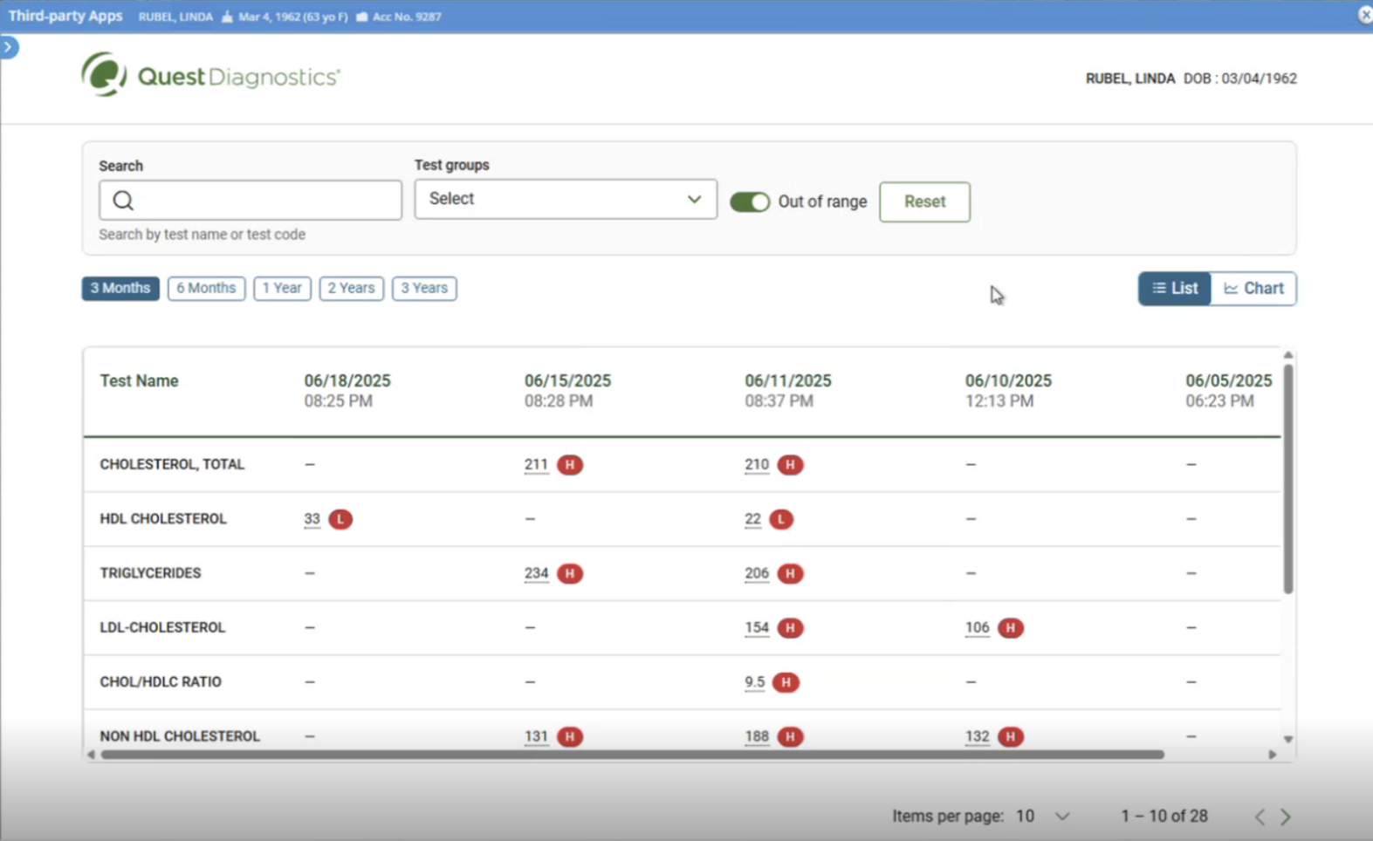
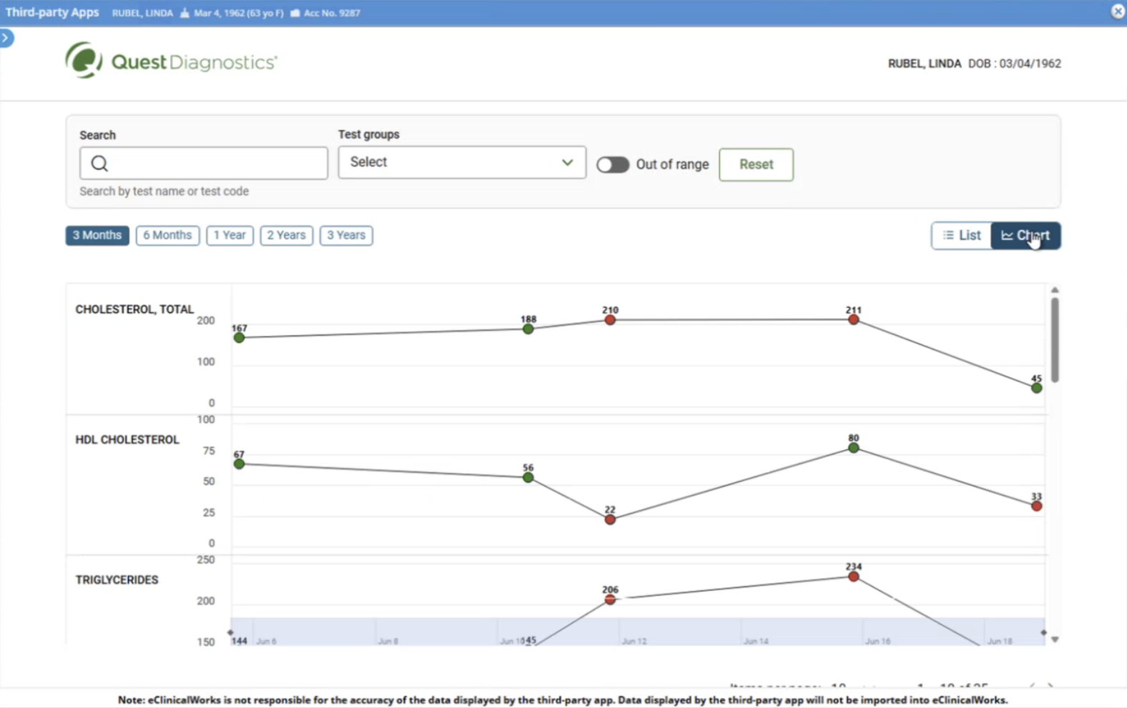
User Journey
1
If user cancels, not verified messaging appears
Accessing application via the patient dashboard
2
3
User views details of test and can choose to print results
User accesses multiple views of patient record

Slide 4
1
User Login
a
b
c
User views the patient profile
User selects “Apps” – “Quest Diagnostics”
User must choose “I agree” to access patient results

Slide 5
Multiple View of Patient Records
2
User can view list of results by different timeframes
User can select tests groups drop down
Drop down Cardiology (example)
User can search by specific test such as Triglycerides (example)
User can select all Out-of-Range test results via toggle view
User can view test results in chart view

Slide 6
View Specific Results and Print or Save
3
User can view details of specific tests throughout
User can print entire report or save as PDF to their computer

Slide 7
Thank you

